Slide 1
Types of seasons
by GVPW

Slide 2
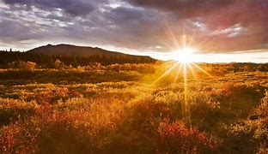
Summer season
Notes:
Summer season

Slide 3
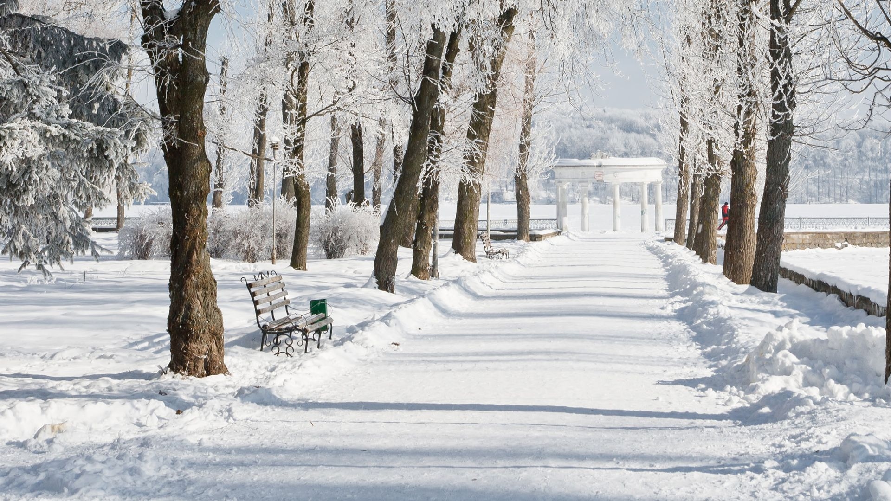
Winter season

Slide 4
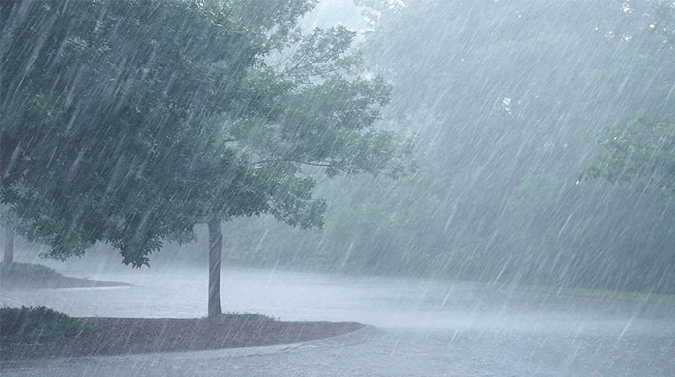
Rainy season

Slide 5
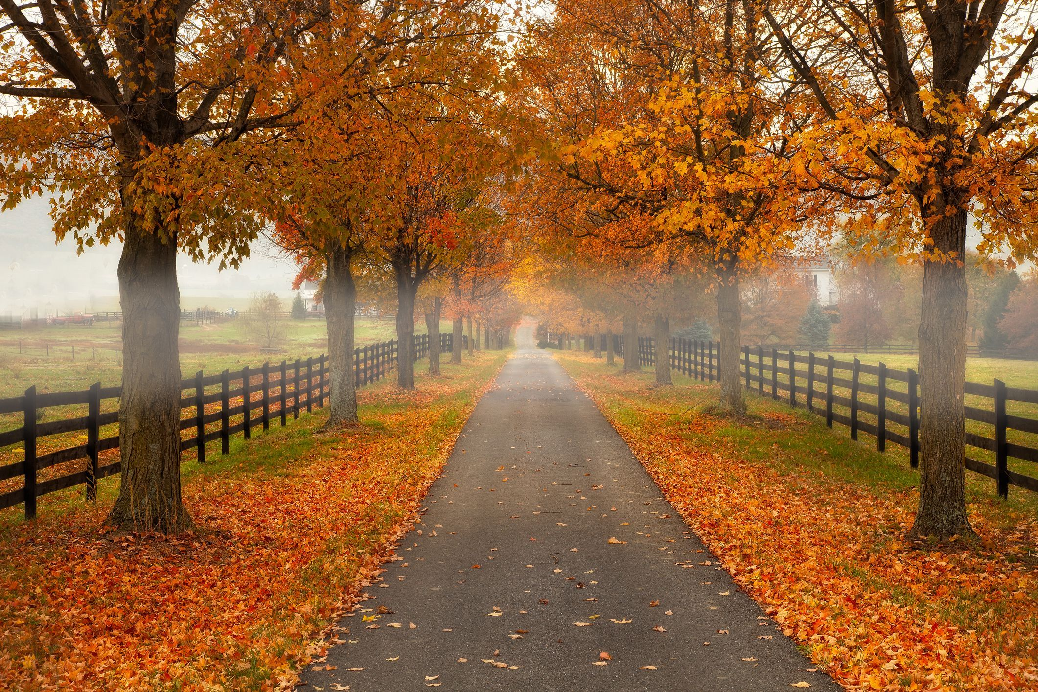
Autumn season

Slide 6
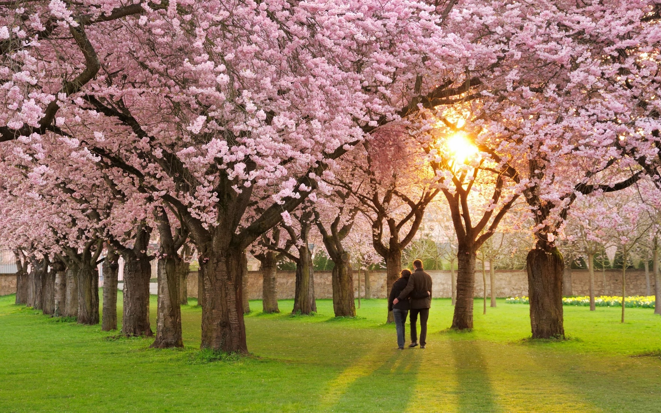
Spring season

